Slide 1
RSPAN
Jason Chang
2009.07.01

Slide 2
Topology
Port 1 RSPAN Source
Port 50 mirror
DES-3552
Source Switch
192.168.0.100/24
1
50
PC 1
192.168.0.3/24
Port 24 RSPAN Redirect
DES-3528 Destination Switch
192.168.0.200/24
1
24
25
Sniffer
192.168.0.5/24
PC 2
192.168.0.10/24

Slide 3
Command
DES-3552 Source Switch ( FW 2.11.B008)
enable rspan
create vlan vlanid 100
config mirror port 50 add source ports 1 both
enable miror
config vlan vlanid 100 name RSPAN_VLAN
create rspan vlan vlan_name RSPAN_VLAN
config rspan vlan vlan_name RSPAN_VLAN source add ports 1 both

Slide 4
Command (cont.)
DES-3528 Destination Switch (FW 2.00.B003)
enable rspan
create vlan vlanid 100
config vlan vlanid 100 add tagged 24-25
config vlan vlanid 100 name RSPAN_VLAN
create rspan vlan vlan_name RSPAN_VLAN
config rspan vlan vlan_name RSPAN_VLAN redirect add port 24

Slide 5
Test Result
PC1 (192.168.0.3) can ping PC2 (192.168.0.10) successfully!
Sniffer PC can capture ICMP packets ( both RX & TX ) form the traffic between PC1 & PC2

Slide 6
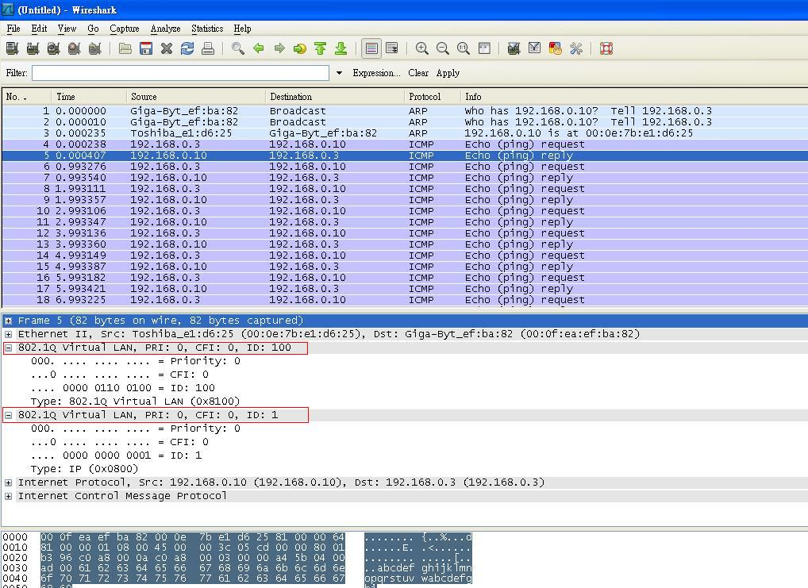
Test Result

